Slide 1

Welcome
to
Ethiopian Management Institute (EMI)
Training Workshop
On
Transformational Leadership and Decision Making
Training Program for MoFPDA
April 23– 27, 2018
Abera Demsis (PhD) Instructor (AAU, AXU…): Researcher, Trainer (EMI, ACTI), & Consultant (UNDP, EDC) +251911336043, abexd2006@gmail.com
EMI, DMTC: Bishoftu, Ethiopia
Good morning!!!

Slide 2
Transformational Leadership & Decision Making

Slide 3
Transformational Leadership & Decision Making

Slide 4
The Training Environment/climate setting
Group Introduction
Expectations and Fears
Ground Rules
Project and Workshop overview

Slide 5
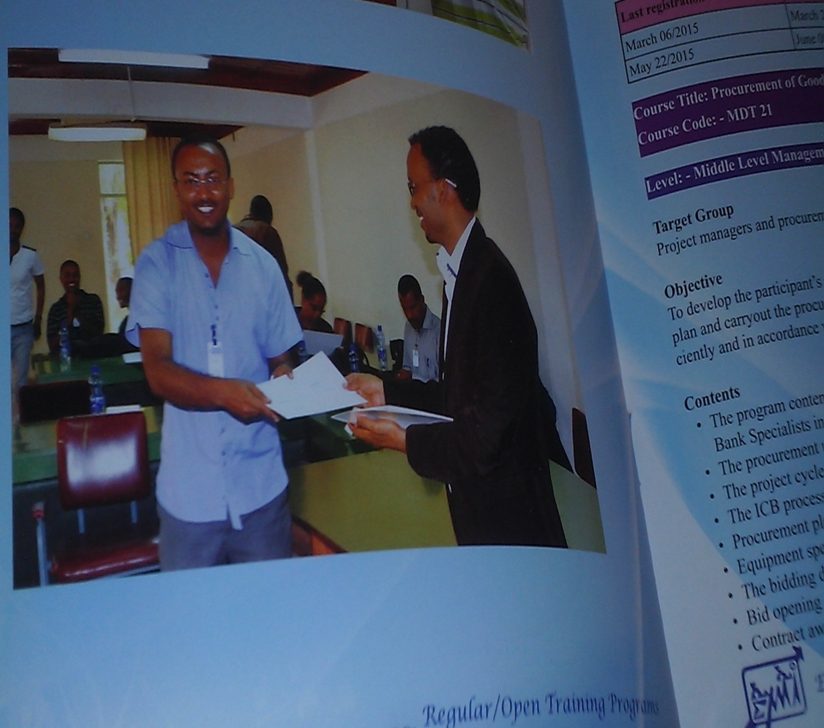
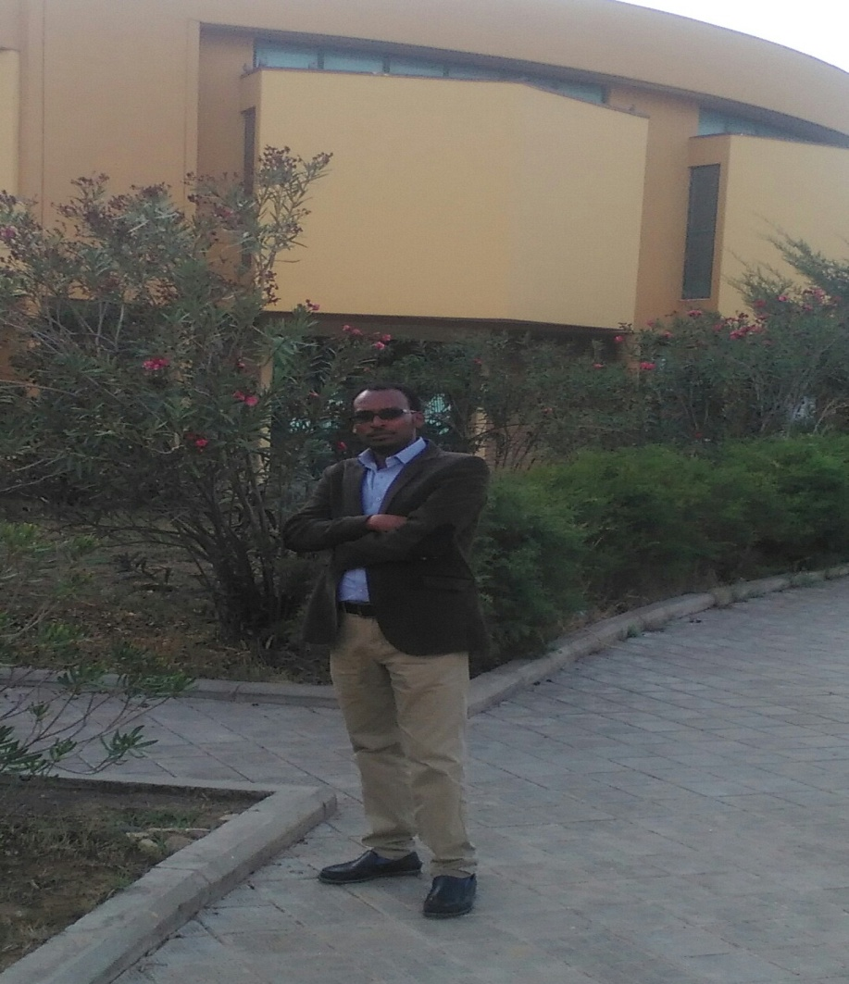
Facilitator:
ABERA DEMSIS(PhD)
BA in MTPA Business Management -AAU
MBA – Business Administration-AAU
DBL- Doctor of Business Leadership: SAU
Instructor -@ AAU & AkU….
Associate consultant and Trainer @EMI & aaccsa, Ati,
NHRD Policy & strategy dev’t team

Slide 6

Self/Group introduction:
Lets get to Know each other
Who are you ?
.
Pair up yourself first.
Do Short interview to your partner-participant for about five minutes &
Then introduce each other to the entire participant.
What is your Education level & profession/discipline?
What is your Job Title & Experience ?
What is Your most admired quality
Name Game Picture your name
1
2
3
4
5

Slide 7
Establishing learning agreements Ground rules (Brain Storm for5’)
Norm Setting
Daily Reporters (Training and other Observations)
Manager
Energizer Team
Schedule
Time keeper

Slide 8
Norms
Put your Mobiles On Silent Mode
Share You Practical Experience
Arrive On Time
Listen To Others
Do Not Interrupts
Any Other……

Slide 9


Setting Training Norms
Mobiles silent or switch off!
Ask questions anytime!
Bring good mood!
Attendance Mandatory
√
√

Slide 10
Put your name in your interest team and day
 | Monday | Tuesday | Wednesday | Thursday | Friday
Time Keepers
Energy Team.
Evaluation Team

Slide 11
Schedule
Training 2:30 - 4:30
Tea break 4:30 - 4:45
Training 4:45 - 6:00
Lunch 6:00 - 8:00
Training 8:00 - 9:30
Tea break 9:30 -9:45
Training 9:45-______

Slide 12
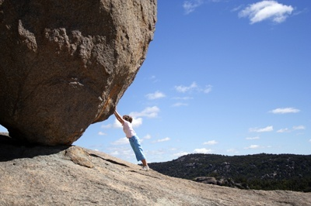
Effective Time Management is Mandatory!!!
The door Closed on Time

Slide 13
Suggestions for Effective Participation
DO:
Ask a question when you have one.
Feel free to share an illustration.
Request an example if a point is not clear.
Search for ways in which you can apply a general principle or idea to your work.
Try to evaluate how you are already performing a skill based on new techniques you are learning.
Think of ways you can pass on ideas to your subordinates and coworkers.
Be skeptical—don’t automatically accept everything you hear.
Feel free to ask for clarification.
Respect the ideas of other Px.

Slide 14
DON’T
Try to develop an extreme problem just to prove the trainer doesn’t have all the answers. (The trainer doesn’t.)
Close your mind by saying, “This is all fine in theory, but...”
Assume that all topics covered will be equally relevant to your needs.
Take extensive notes; the handouts will satisfy most of your needs.
Don’t try to show how much you know by monopolizing class time.
Engage in side talk.
Interrupt others.

Slide 15
What do you Expect from this training ?
Write your Expectations!
List down your Fears of achieving your expectations , if any!!!
Write down a Solutions for that fears!!!
Expectations | Fears | Solutions

Slide 16
What do you expect from this training?
16
Training will neither make a fish fly nor a bird swim,
But
It certainly will help the fish to swim faster and the bird fly higher

Slide 17
Entry Level Self Assessment
Explore/ponder the level of skill &confidence of yours on major components of the leadership skills i.e.,
Leadership, Management, EI, Coaching/Mentoring, Team Building.
Project & workshop overview
Put the prepared scale on a flipchart stand
put your initial (ASK) on the scale where you think is your level of knowledge and confidence on each component.
Put your KSA again on the scale at the end of the program (Post-training)
Together evaluate transfer of learning (if there is any development after the training is conducted)

Slide 18
EXAMPLE: Thermo Scale
LSP
MGMT
EI
C&M
TEAM Bldg

Slide 19

How do you rate your knowledge and skills in the following areas? Please tick (√) the column most applicable to you:
Training components | Highly Adequate | Adequate | Fairly Adequate | Inadequate | Highly Inadequate
Leadership Concepts,
Leadership practices,
Leadership Vs management
Leadership Theories
Transformational Leadership
Transactional Leadership
Emotional intelligence,
Coaching Vs mentoring
Team building & Leadership
Decision making & problem solving

Slide 20
Group formation
Group One (LUCY G.)
Group Two (selam G.)
Group Three (selemme G.)
Group Four (Qeerroo G.)
Group Five (Hidassie G.)
How many of you have worked as:
LEADERS so far?
A #(1,2,3…) be given to each

Slide 21
“Remember,
Training is not what is ultimately important…
performance is.”

Slide 22
Workshop overview
Concepts of leadership,
Leadership vs management,
Transformational Leadership theory
Emotional intelligence
  Self-awareness & Self regulation and self motivation
  Empathy and social Skill)
Coaching and mentoring Skills
  Coaching
  Mentoring
  Training and consulting
Team building and development
  Team, Group & Team Development Process
  Decision making and problem solving

Slide 23
SESSION ONE
INTRODUCTION TO LEADERSHIP

Slide 24

Group formation
Group One (ለውጥ)
Group Two (ሉሲ)
Group Three (ስማርት)
Group Four (እድገት)
. Group five (ህዳሴ)
. Group six (ሰላም)
How many of you have worked as:
LEADERS so far?
A #(1,2,3…) be given to each
Who Am I?
What Skills Do I Need?
Where Am I Headed?

Slide 25
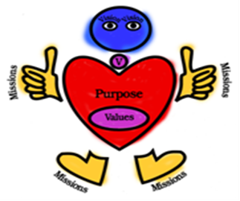

Slide 26
ARE YOU A LEADER?
SELF EXERCISE
ON YOUR LEADERSHIP POTENTIAL

Slide 27
Leadership Potential
There are no right or wrong answers, so don’t try to pick what you think is the right answer. Be honest in answering the questions, so that you can better understand yourself and your behavior as it relates to leadership.
For each pair of statements distribute 5 points, based on how characteristic each statement is of you.
.

Slide 28
If the first statement is totally like you and the second is not like you at all, give 5 points to the first and 0 to the second.
If it is the opposite, use 0 and 5. If the statement is usually like you, then the distribution can be 4 and 1, or 1 and 4.
If both statements tend to be like you, the distribution should be 3 and 2, or 2 and 3.
Again, the combined score for each pair of statements must equal 5.
Here are the scoring distributions for each pair of statements:
0–5 or 5–0 One of the statements is totally like you, the other not like you at all.
1–4 or 4–1 One statement is usually like you, the other not.
2–3 or 3–2 Both statements are like you, although one is slightly more like you

Slide 29
1. I’m interested in and willing to take charge of a group of people.
I want someone else to be in charge of the group.
2. When I’m not in charge, I’m willing to give input to the leader to improve performance.
When I’m not in charge, I do things the leader’s way, rather than offer my suggestions.
3. I’m interested in and willing to get people to listen to my suggestions and to implement them.
I’m not interested in influencing other people.

Slide 30
4. When I’m in charge, I want to share the management responsibilities with group members.
When I’m in charge, I want to perform the management functions for the group
5. I want to have clear goals and to develop and implement plans to achieve them.
I like to have very general goals and take things as they come.
6. I like to change the way my job is done and to learn and do new things.
I like stability, or to do my job the same way; I don’t like learning and doing new things.
7. I enjoy working with people and helping them succeed.
I don’t really like working with people and helping them succeed.

Slide 31
To determine your leadership potential score, add up the numbers (0–5) for the first statement in each pair !
The higher your score, the greater your potential to be an effective leader.
However, the key to success is not simply potential, but persistence and hard work.
You can develop your leadership ability through this course by applying the principles and theories to your personal and professional lives.
0 5 10 15 20 25 30 35
Low leadership potential High leadership potential

Slide 32
Brain storming
How do you understand Leadership?
  What is leadership to you?
Who do you think is a leader in your organization?
List three persons whom you know and refer as your role model leaders
  Give rationales why you consider them as leaders
Discuss in your respective group and present back to class

Slide 33
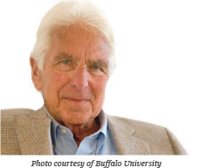
Excerpt
Leadership is like beauty ~
it’s hard to define
but
you know it, when you see it.
~ Warren Bennis, 1989,2009
Prof. Warren Bennis,
On becoming a leader
“Leadership is influence - nothing more, nothing less” J. Maxwell
Leadership is the influencing process of leaders and followers to achieve organizational objectives through change. Lussier and Achua, 2010
.
“Leadership is the capacity to translate vision into reality” W. Bennis
“The only definition of a leader is some one who has followers” P. Druker

Slide 34
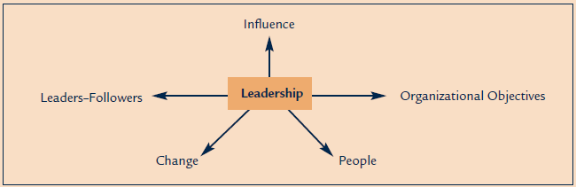
WHAT IS LEADERSHIP?

Slide 35

What is Leadership?
Leadership is a process by which a person influences others to accomplish a mission, task, or objective and directs the organization in a way that makes it more cohesive and coherent.

Slide 36
‘‘ Leadership is a function of knowing yourself, having a vision that is well communicated, building trust among colleagues, and taking effective action to realize your own leadership potential.”
Warren Bennis

Slide 37
‘‘ A leader is an individual who significantly affects the thoughts, feelings, and/or behaviours of a significant number of individuals.”
Howard Gardner

Slide 38


Leadership
Leadership is influencing others to work diligently toward achieving their goals.
  Clearly stating your vision!
  Explaining your plan for attaining your vision!
  Instilling confidence and optimism!
  Expressing confidence in those you lead!!!

Slide 39
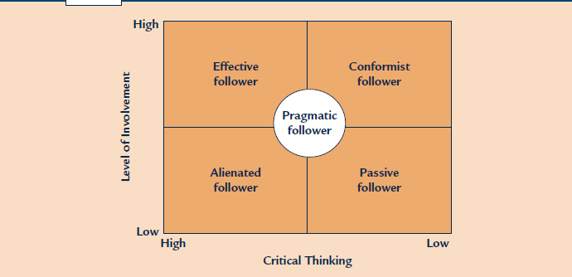
Follower
A follower is a person who is being influenced by a leader.
A follower can be a manager or a non-manager.
Good followers are not “yes people” who simply follow the leader without giving input that influences the leader.
In short, effective leaders influence followers, and their followers influence them.
The qualities needed for effective leadership are the same as those needed to be an effective follower.
Who are effective followers?
Mention some of their qualities?

Slide 40
Good Morning!!!!
Where are we??

Slide 41
Group Discussion
List some of the leadership characteristics? are these a result of nature or nurture? Discuss
What do we mean by “power” in leadership and what are the common sources of power for a leader?
Leadership Vs Management! Discuss their respective activities.
What are leadership skills? Discuss!
What do you think are the common leadership styles commonly exercised?
Discuss in group &reflect back to the plenary!

Slide 42

What it takes to be a Leader
Vision
Listening
Confidence
Availability
Participation
Motivation/inspiring
Strategy
Decisiveness
Focus
Creativity
Delegation
Honest

Slide 43
Visionary Characteristics of Effective Leadership
Objectivity
Confidence
Concern
Clarity and effective communication
Social and emotional maturity
Energy
Timing
Courage
Faith
Achievement drivers
Morality
Integrity ; and
Leading by example.

Slide 44
From the following qualities of leaders select 5 most elements which you think are very relevant
____Ambitious | ____ Honest
____Broad-Minded | ____ Imaginative
____ Caring | ____Independent
____ Competent | ____Inspiring
____ Cooperative | ____ Intelligent
____ Courageous | ____ Loyal
____ Dependable | ____Mature
____ Determined | ____ Self-Controlled
____ Fair-Minded | ____ Straightforward
____ Forward-Looking | ____ Supportive

Slide 45
Total Sample ( Research out put of a sampled respondents)
26% Ambitious | 85% Honest
40% Broad-Minded | 18% Imaginative
20% Caring | 6% Independent
64% Competent | 69% Inspiring
26% Cooperative | 42% Intelligent
21% Courageous | 18% Loyal
37% Dependable | 16% Mature
28% Determined | 11% Self-Controlled
35% Fair-Minded | 31% Straightforward
70% Forward-Looking | 36% Supportive

Slide 46

Characteristics of an Effective Leader
An effective leader is someone
    who knows how to Inspire and relate to subordinates;
    able to Convince subordinates that the organisational vision is not only important but attainable;
    able to Challenge them with goals, projects, tasks and responsibility that allow them to feel a sense of personal success, achievement, and accomplishment;
    Rewards subordinates who perform well with recognition, money and promotions
Edwin A. Locke (1999)

Slide 47

Characteristics…
Have a clear forward vision
Having Clear Values
Knowledgeable and intelligence
Able to Inspire
Able to Lead by Example
Take responsibility
Courageous
Accessible
Approachable
Available
Able to create a spirit of collaboration and community
Continuously improve
Problem solving skills
Effective communication skills
Able to generate new ideas
Good learner and listener
Enthusiastic
Optimistic

Slide 48
List some of the leadership characteristics? are these a result of nature or nurture? Discuss

Slide 49
POWER AND LEADERSHIP INFLUENCE
Reward power
Legitimate power
Referent power
Expert power
Coercive power

Slide 50
Oral Discussion
Which type of source of power is frequently in use in your context ?
Why ?
According to your understanding and belief which types of power is the most powerful weapon for the leader ?
Power | Personal charisma | Formal authority

Slide 51
Are good leaders Born Or Made?
Discuss!!!
Reflect to the plenary.
Trait theory of leadership
Behavioral theories of leadership
Contingency theories of leadership

Slide 52
Leadership Versus Management

Slide 53
Leadership vs Management
ESSENCE | LEADERS | MANAGERS
Focus | Leading people | Managing work
Have | Followers | Subordinates
Horizon | Long-term | Short-term
Seeks | Vision | Objectives
Approach | Sets direction | Plans detail
Decision | Facilitates | Makes
Power | Personal charisma | Formal authority
Appeal to | Heart | Head
Energy | Passion | Control
Culture | Shapes | Enacts
Dynamic | Proactive | Reactive
Persuasion | Sell | Tell
Style | Transformational | Transactional
Exchange | Excitement for work | Money for work
Likes | Striving | Action
Wants | Achievement | Results
Risk | Takes | Minimizes
Rules | Breaks | Makes
Conflict | Uses | Avoids
Direction | New roads | Existing roads
Truth | Seeks | Establishes
Concern | What is right | Being right
Blame | Takes | Blames
Your position as manager, supervisor, director, etc. may give you the authority to accomplish certain tasks and objectives in the organization
This power does not make you a leader… it simply makes you the boss.
Leadership makes people want to achieve high goals and objectives, while, on the other hand, bosses tell people to accomplish a task or objective

Slide 54
Leadership vs Management
Leadership | Management
Produces change and movement | Produces order and consistency
Establishing direction | Planning and budgeting
Creating a vision | Establishing agendas
Clarifying the big picture | Setting timetables
Setting strategies | Allocating resources
Aligning People | Organizing and Staffing
Communicating goals | Provide structure
Seeking commitment | Making job placements
Building teams and coalitions | Establishing rules and procedures
Motivating and Inspiring | Controlling and Problem Solving
Inspiring and energize | Developing incentives
Empowering subordinates | Generating creative solutions
Satisfying unmet needs | Taking corrective action

Slide 55
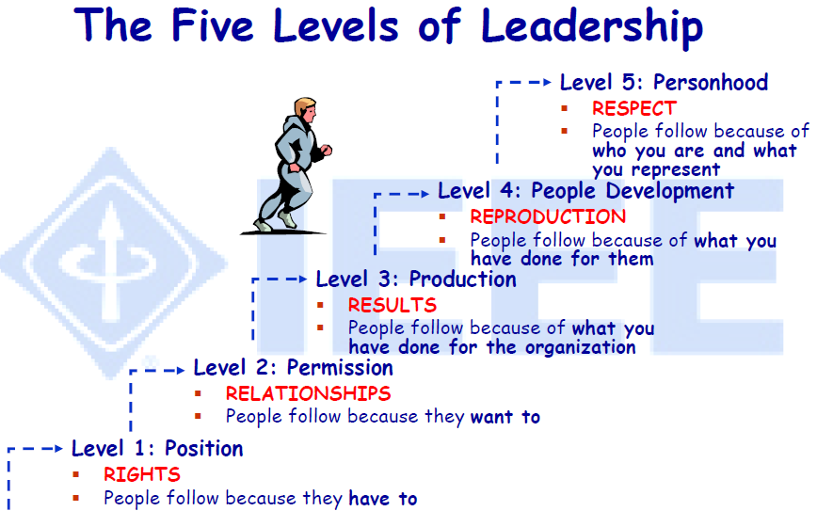
5-LEVELS OF LEADERSHIP by Maxwell

Slide 56
Group Exercise One
After watching the video/figure on five levels of leadership, discuss on the following issues.
Does a position makes some one a leader ? Why ?
Describe the five levels of leadership ?
currently in which level are your in ?
What will be your strategy to move to the next level of leadership ?

Slide 57
Good morning!
Where are we??

Slide 58
Practices of Leadership
Inspiring a shared vision
Encouraging the heart
Modeling the way
Challenging the process
Enabling others to act
Group Activity
Assess your organization’s leadership practice as per the above characteristics

Slide 59
leadership theories
Trait theory of leadership
Behavioral theories of leadership
Contingency theories of leadership
Discuss!!!
Reflect to the plenary.

Slide 60
Transformation Leadership Theory

Slide 61
Transformational Model of Leadership
Is a new paradigm of leadership
Involves inspiring followers to commit to shared vision and goals,
Challenging them to be innovative, problem solvers and
Developing followers’ leadership capacity via coaching ,mentoring and provision of both challenge and support.

Slide 62


Transformation Lsp is a fundamental shift in the deep orientation of a person, organization or society such that the world is seen in new ways and new actions and results become possible that were impossible prior to the transformation.
Focuses on what leaders accomplish rather than personal characteristics and follower reactions.
Are not constrained by their followers' perceptions but are free to act to transform (change) their followers' views.

Slide 63
To become a transformational leader one needs to make a shift of mind:
From
Individual heroics
hopelessness and pessimism
Blaming others for problems
Scattered, disconnected activities
Self-absorption
To
Collaborative actions
Hope and possibility
Taking responsibility for challenges
Purposeful, interconnected actions
Generosity and concern for the common good

Slide 64
THE FULL RANGE LEADERSHIP MODEL

Slide 65
Transformational VS Transactional Leadership
Transformational
Transactional
Empowers
Bargains
Inspires by Vision, Ideas
Is task centred
Long - Term focus
Short/Medium Term Focus
Challenges
Coaches sheltered learning
Rewards informally, personally
Rewards formally
Emotional, Turbulent
Comfortable, Orderly
Notes:
Transactional - leaders who guide or motivate their followers in the direction of established goals by clarifying role and task requirements
Transformational - leaders who inspire followers who transcend their own self-interests and who are capable of having a profound and extraordinary effect on followers.

Slide 66
Self-Assessment
Multifactor Leadership Questionnaire
INSTRUCTIONS:
This questionnaire provides a description of your leadership style as you perceive it.
Please answer all items by making a tick ( √ ) mark in front of each scaled numbers as: 0 1 2 3 4.
28 descriptive statements are listed below.
Judge how frequently each statement fits you.
The word others may mean your followers, clients, or group members.
Key: 0=Not at all; 1=Once in a while; 2=Sometimes; 3=Fairly often; 4=Frequently, if not always

Slide 67
Key: 0=Not at all; 1=Once in a while; 2=Sometimes; 3=Fairly often; 4=Frequently, if not always
I provide others with assistance in exchange for their efforts
I re-examine critical assumptions to question whether they are appropriate.
I focus attention on irregularities, mistakes, exceptions, and deviations from standards
I talk about my most important values and beliefs
I seek differing perspectives when solving problems
I talk optimistically about the future
I instill pride in others for being associated with me.
I discuss in specific terms who is responsible for achieving targets.
I talk enthusiastically about what needs to be accomplished.
I specify the importance of having a strong sense of purpose.

Slide 68
I spend time teaching and coaching.
I make clear what one can expect to receive when performance goals are achieved.
I go beyond self-interest for the good of the group.
I treat others as an individual rather than just as a member of group.
I act in ways that build others respect for me.
I concentrate my full attention on dealing with mistakes, complaints, an failures
I consider the moral and ethical consequences of decisions
I keep track of all mistakes
I display a sense of power and confidence
I articulate a compelling vision of the future

Slide 69
I direct my attention toward failures to meet standards
I consider an individual as having different needs, abilities, and aspirations from others
I get others to look at problems from many different angles
I help others to develop their strengths
I suggest new ways of looking at how to complete assignments
I emphasize the importance of having a collective sense of mission
I express satisfaction when others meet expectations
I express confidence that goals will be achieved

Slide 70
Scoring interpretation
IS | Score | IIB | Score | IM | Score | IIA | Score | IC | Score | CR | Score | MBEA | Score
2 |  | 4 |  | 6 |  | 7 |  | 11 |  | 1 |  | 3
5 |  | 10 |  | 9 |  | 13 |  | 14 |  | 8 |  | 16
23 |  | 17 |  | 20 |  | 15 |  | 22 |  | 12 |  | 18
25 |  | 26 |  | 28 |  | 19 |  | 24 |  | 27 |  | 21
Total¹= |  | Total²= |  | Total³= |  | Total⁴= |  | Total⁵= |  | Total⁶= |  | Total⁷=
Grand Total Average= |  |  |  |  |  |  |  |  |  | Grand total average

Slide 71
Components of Transformational Leadership
Idealized influence
  Show great determination, be a role model.
  Make personal sacrifice.
  Leaders take responsibility for their action.

Slide 72
…Components
Inspiring motivation
Leaders articulate /clear shared visions and goals and how they are to be achieved.

Slide 73
CONT’
Intellectual stimulation
initiate and instill changes
challenge the existing practices and acts of others and organization as a whole
encourage others to question their assumptions and prevailing practices
show new ways of looking at old problems, they challenge the existing boundaries and the mental prisons people put themselves into.

Slide 74
CONT’
Individualized Consideration
the leader provides a means for people to develop commitment, a common goal around which to rally, and a way for people to feel successful.
get in touch with the specific growth and achievement needs of their followers
engage in coaching and mentoring activities so as to help the followers reach their highest possible potential

Slide 75
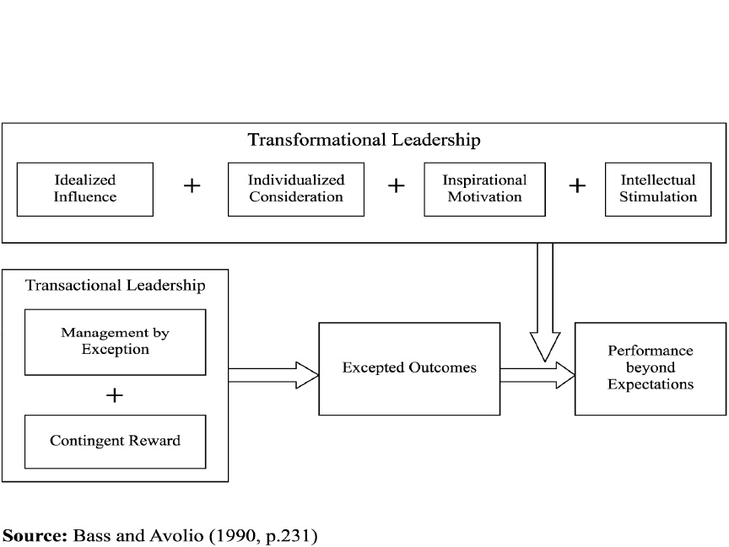
The additive effect of Transformational and Transactional Leadership
Expected outcomes

Slide 76
Group Discussion on Transformational Leadership
Purpose: To help trainees discuss and share their experiences on the roles transformational leaders have
Describe how clearly the leader articulates a vision for the future.
Detail how the leader communicates optimism and confidence in followers to achieve excellence.
Illustrate how the leader displays exceptional conceptual skills in approaching challenges in novel and unique ways.
Explain how the leader is able to draw out the best from the followers.
Time allotted: 1 hour

Slide 77
LEADERSHIP IS
A CONVERSATION

Slide 78
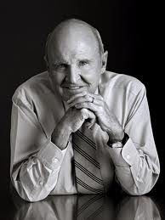
Engagement
“There are only three measurements that tell you nearly everything you need to know about your organization’s overall performance: employee engagement, customer satisfaction, and cash flow…It goes without saying that no company, small or large, can win over the long run without energized employees who believe in the mission and understand how to achieve it…”
- Jack Welch, former CEO of GE

Slide 79
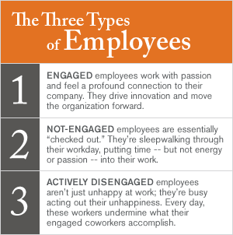
Employee Engagement
Does not mean employee happiness.
Doesn’t mean employee satisfaction.
Is the emotional commitment:
  To Your Work
  To Your Company
  To Give Your Discretionary Effort

Slide 80
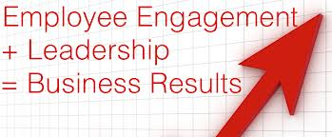
Major Factors That Impact Engagement
Being Part of a Winning Organization.
Working for Admired Leaders.
Having Positive Working Relationships.
Doing Meaningful Work.
Gaining Recognition and Appreciation.
Living a Balanced Life.
Source: The Banff Centre

Slide 81

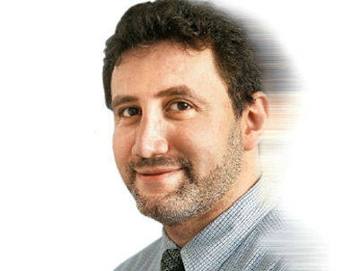
What Does That Mean For Leaders?
According to Dr. Boris Groysberg, leaders must engage employees through “Organizational Conversation.”
Leaders can create mental or emotional proximity.
Dr. Boris Groysberg, Professor of Business Administration, Harvard University

Slide 82
Proximity
The state, quality, sense, or fact of being near or next; closeness.
Physical proximity is becoming a challenge for leaders and employees
Mental or emotional proximity appear to be the leadership opportunity

Slide 83

Interactivity:
Use Communication Channels
Promoting Dialogue
Using Social Technology
How Do You Message People?

Slide 84

Tool: Finding the Drift
Drift, The act or condition of being carried along by the currents.
Drift is the background music in organizations:
  “We are overworked.”
  “You can’t trust the management.”
  “Our objectives are unrealistic.”
What is the drift in your organization?
It is essential that you identify and shape it!

Slide 85
The Conversations for
Accomplishment Model
Accomplishment
And Completion
Action
Opportunity
Possibility
Background
of Relatedness

Slide 86
Tool: Seven Conversations for Extraordinary Results
Conversation for being related – relevance to another.
Conversation for possibility – standing for a future of possibility.
Conversation for opportunity – tactical language for achieving a possibility.
Conversation for action – specific who, what, when.
Conversation for breakdown – dealing with resistance.
Conversation for acknowledgement – genuine expression of appreciation.
Conversation for completeness –being whole.
    For how it is for the other
    For positive regard
Assessments &assertions
Sharing
Questions for clarification
    Listening for Possibility
    Listening for Alignment
Affirmations
Declarations
Questions for Clarity
    Listening for Enhancement
    Listening for Feasibility
Speculative Assessments
Declarations
Promise and request
Levels of Intensity of Requests
Responses to requests
Commitment

Slide 87

Exercise
Is your organization’s strategy being implemented?
How are you intentionally conversing strategy into results?

Slide 88

Intentionality: Convey Strategy
Pursuing an Agenda
Taking a Stand for Possibility
Driving Alignment
Crafting the Agenda

Slide 89
Tool: Having Breakthrough Conversations
What is the conversation and for whom?
Create the Context (Possible questions to consider):
  What is the context you want to create from this conversation?
  What is your Stand for yourself? For them?
  What is the experience or result you want to cause?
  Are you thinking from “Something is Possible”?
What is Their World? What is Your World? In other words, think through the concerns, issues, challenges and worries of your audiences. How will you bridge their world with your conversation?
What is the intention you have for the conversation?
What are the specific outcomes you are committed to producing?
How do you wish to close your conversation?

Slide 90
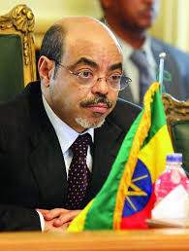
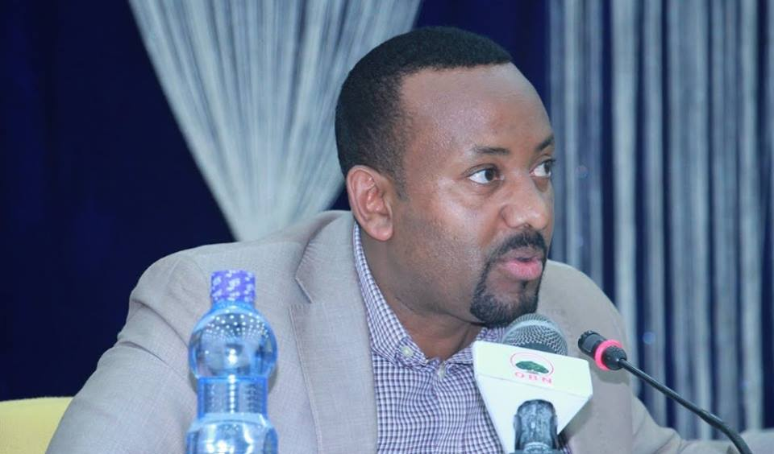
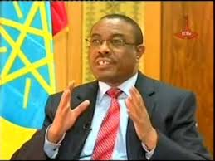
When You Are @ the Conversation
How Will You Show Up?

Slide 91

Going Forward
Conversation Occurs in Every Organization.
As a Leader, how will you impact the conversation?
Leadership Is Your Conversation!

Slide 92

Strongly Consider This Book!
Speak As Well As You Think
An Executive’s Guide To Excellence In Public Speaking.
By John M. Vautier and
John J. Vautier

Slide 93
ANY QUESTION?

Slide 94
Good Morning!!!!
Where are we??

Slide 95

To coaching , mentoring and change management Training Session

Slide 96
Reflection
What do you think is coaching?
What experience do you have regarding coaching ?
What do you think is the difference between coaching and mentoring?
Why do leaders need to develop coaching skill?

Slide 97
Why leaders need coaching skills
Before you are a leader, success is all about growing yourself. When you become a leader success is all about growing others.”
Jack Welch
“A good leader inspires people to have confidence in the leader. A great leader inspires people to have confidence in themselves.” Eleanor Roosevelt

Slide 98
Coaching
Coaching is a process whereby awareness of the potential for change, development and improvement is awakened in an individual; and that individual takes personal responsibility for driving the change process.
Unlocking a person’s potential to maximize their own performance.
It is helping them to learn rather than teaching them.

Slide 99
The Right Time for Coaching
When employees are:-
Failing to perform their work to an acceptable standard.
In need to acquire new skills for their job which is evolving,
Have potential for promotion, but need to develop more skills first.
Has a bad behavior that is affecting other team members/customers

Slide 100
COACHING IS
Continuous
Asking
Listening
Caring
What they think
Possibilities
Clarifying
Discovering
Encouraging
Guiding
COACHING is not
A one time event
Telling
Talking
Avoidance
What you think
Rigid
Blaming
Disciplinary action
Discouraging
panacea
Controlling

Slide 101
Case Study

Slide 102
Discussion points
How did helen and the supervisor start the process?
How did the supervisor help helen to analyze the problem and reach solution ?
Are there any learning points for you to change yourself as a coach?

Slide 103
Coaching process
Define what you want to discuss
Decide what to do about the performance problem
Discuss the causes of the problem/current situation/
Identify options
Decide on specific action to be taken
Follow up

Slide 104
Coaching skills
Proactive listening
Goal Setting
Questioning skill
Giving Feedback

Slide 105
Learning Questions
Open-ended (not yes/no)
Comes from your sincere desire to learn about the person and their situation.
Calculated to bring in useful information for both coach and coachee.
Supportive in tone – won’t generate defensiveness.

Slide 106
Learning Questions Exercise
Identify a situation in your life where you would be willing to be coached.
With a partner decide who will be coach and a coachee
Coachee tells a little about the situation where they are requesting coaching
Stop and coach writes 5 learning questions.
Coach asks learning questions only. Listen carefully to learn what is so.
Switch

Slide 107
Feedback
The way in which feedback is administered can make or break the relationship.

Slide 108
How to give feedback in coaching sessions
Ask for people’s feedback on themselves before you give yours.
Ensure that you ask people to give themselves some positive feedback, so that they recognize their strengths.
Give people the chance to tell you what they would do differently if they could do it again.
Give specific and realistic feedback
Ensure that you give authentic positive feedback where it is deserved.

Slide 109
Feedback Approach
What they should continue to do (behavior to retain),
what actions they should do more of (behavior to increase) or
what actions they should reduce or eliminate (behavior to decrease).

Slide 110

Self Assessment on Coaching skills

Slide 111
Reflection
What does mentoring mean to you?
Do you have any mentoring experience?
Can you think of a person who has been a “mentor” to you? Who was it and what was the situation?

Slide 112
Reflection
“A single conversation across the table with a wise man is worth a month’s study of books.” Chinese proverb

Slide 113
Mentoring
Trusted advisor, friend, teacher and wise person.
form of development where one person invests time, energy, and personal knowledge in assisting another person to grow and learn.
Employees (mentees) pair with more experienced co-workers (mentors) in order to gain knowledge, skills, experience, information and advice.
it’s about teaching individuals how to understand and use their potential to fullest.

Slide 114
The role of the mentor
Provide guidance based on needs
Share personal experiences, successes, and failures
Keep commitment
Provide encouragement and feedback
Keep information confidential
Be available
Help mentee to resources

Slide 115
Misperceptions of Mentoring
Mentors need to be older
Only the person being mentored benefits.
Taking the time to mentor decreases productivity.
The public service is too busy to have time for mentorship.

Slide 116
Opportunities For Mentoring
For new employees
When an employee receives a promotion or new responsibilities
to develop individuals potential
When things occur which challenge individuals dreams or course of action
Notes:
Coaching – mainily gap filling
Mentoring- develop potential

Slide 117
Reflection
Does mentoring benefit the mentor?
How good are you at sharing your knowledge and experience to others?
What are the probable causes that hinder people from sharing their knowledge and experience to others?

Slide 118
Benefits of mentoring for the mentor
Opportunity to give back
Personal satisfaction
Helps to increase sense of worth
Helps to strength interpersonal relationship
Increase understanding of a subject by teaching others

Slide 119
The mentoring conversation
Where are they now?
  What’s going well?
  What do they want to change?
Where do they want to be?
  What does success look like?
  How would they know it was a success?
How do they get there?
  What knowledge, skills and experience do they have that will help?
  What ideas and options are there?
What action will they take?
  What are they prepared to do?
  How confident are they about doing it?
  What support do they need?

Slide 120
Phases of Mentoring
Phase 1-Observe
In this first phase, the person you teach/mentee observes the mentor or someone else doing the job.
Why is this job important?
What are the key components of this job?
What are the cautions?
What timing issues are important?

Slide 121
Phases of Mentoring
Phase 2- Participate
Decide how to share the task
Make sure Mentee Understand
Set enough time to learn
“Tell me and I forget, teach me and I may remember , involve me and I learn. ” Benjamin Franklin

Slide 122
Phases of Mentoring
Phase 3- Conduct
Once the mentor done the task with your person, it’s time for the mentee to fly solo. There are four questions that you, as a mentor/instructor, must resolve before beginning the conducting stage.
How can the mentee demonstrate competency?
What level of competency will be adequate?
How much inaccuracy will be allowed?
When will unsupervised work be allowed?

Slide 123
Commonalities of Coaching and Mentoring
Provide individuals and teams with opportunities for gaining new skills, and personal development
Offer learning opportunities geared to individual needs
encourage a positive attitude to learning
Help improve communication within the organization
Increase individual and team commitment to an organization and its goals
Allow individuals to gain a greater insight into the organization’s workings
Improve levels of professional success.
provide flexibility in the learning process

Slide 124
Emotional Intelligence

Slide 125

Emotion!
What is it?

Slide 126
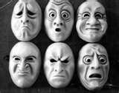

Slide 127
Emotions…
A conscious mental reaction subjectively/based on feeling not on facts/ experienced as strong feeling usually directed toward a specific object and typically accompanied by physiological and behavioral changes in the body.
Emotions serve a biological purpose
Notes:
Emotional Intelligence
a person’s ability to understand his or her own & others’ emotions
apply this to life’s tasks
Emotional intelligence is the ability to
perceive & express emotions
use them to facilitate thinking
to understand & reason with emotions
manage emotions effectively

Slide 128
Emotions
“Emotions are powerful things; whether we like it or not, emotions are involved in every single decision and action we take.
If we don’t acknowledge their importance within us, and within the people we live and work with, then we’re missing a trick”
Sparrow and knight (2006)

Slide 129
Emotions . . .
Discuss
Emotions are good advisers but terrible masters.

Slide 130
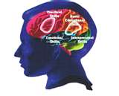
EQ or EI
EI is the capacity for awareness of our own moods and attitudes and of those of others and the ability for managing our selves well in our relationships with others” Goleman, 1998
EI is the foundation for leadership and is “a type of social intelligence that involves the ability to monitor one’s own and others emotions, to discriminate among them, and to use the information to guide one’s thinking and actions. Mayer & Salovey, 2002

Slide 131
Relationship Between Observations, Interpretations and Emotions
From F. Kofman, "Emotion, Understanding the Basics"
5.External World:
Events and observable
facts
Perception: Observation
2. Evaluations. Interpretation: Thoughts and
Vicious circle
4. Action: behavior in response to the perceptions, interpretations and emotions
3. Emotion: Feeling created by the conscious and unconscious thoughts and interpretations

Slide 132
Reflection
Which one do you think is more important to a leader IQ or EQ?

Slide 133
EQ
“If your emotional abilities (EQ) aren’t in hand, If you don’t have self-awareness, If you are not able to manage your distressing emotions, If you can’t have empathy and have effective relationships,
Then no matter how smart (IQ) you are, you are not going to get very far”.
Daniel Goleman (1998)

Slide 134
Emotional Intelligence
What is emotional intelligence?
Discuss and reflect!

Slide 135
Emotional Intelligence
Emotional intelligence (EI) refers to an assortment of non-cognitive
  skills,
  capabilities, and
  competencies
that influence a person’s ability to succeed in coping with environmental demands and pressures.
It’s composed of five dimensions

Slide 136
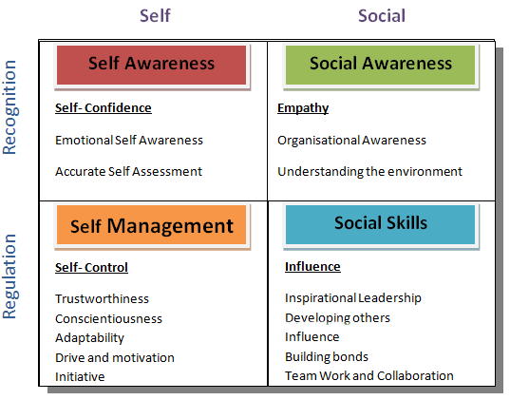
Emotional Intelligence Competencies

Slide 137
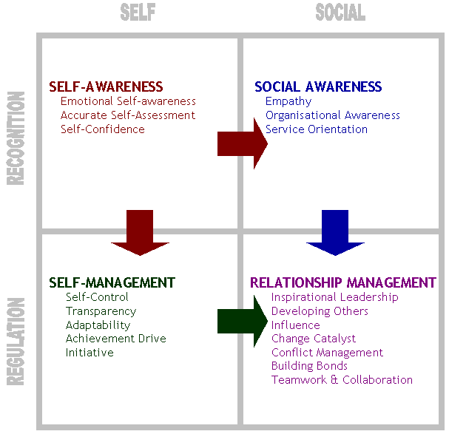
Emotional intelligence

Slide 138
Self Awareness
Being aware of what you are feeling.
It is exhibited by self-confidence, realistic self-assessment, and
A self-deprecating/criticism sense of humor.

Slide 139
Self Management
The ability to manage your own emotions and impulses.
It is exhibited by trustworthiness and integrity, comfort with ambiguity, and openness to change.

Slide 140
Self Motivation
The ability to persist in the face of setbacks and failures.
It is exhibited by a strong drive to achieve, optimism, and high organizational commitment.

Slide 141
EMPATHY
The ability to sense how others are feeling.
It is exhibited by expertise in building and retaining talent, cross-cultural sensitivity, and service to clients and customers.

Slide 142
Social Skills
The ability to handle the emotions of others.
It is exhibited by persuasiveness, and expertise in building and leading groups and teams
EI differs from emotional labor because the latter is a job requirement (the demand to smile, express enthusiasm, etc.) while the former is regarded as a personality trait.

Slide 143
….Social Skills
A person with low EI may control his emotions because of a request from a manager (thus engaging in emotional labour), but might otherwise not do so.

Slide 144
ANY QUESTION?
EI, PRACTICAL CASE?

Slide 145

Forming
and
Leading Teams

Slide 146
Reflection
What is a team to you?
Have you ever been on a team? What was that like for you?

Slide 147

What is a team?
One answer: A team is a group of people who need to work together closely to get a task done well.

Slide 148
Teamwork and its importance
Working towards a common goal.
Synergy
Multiple perspectives
  better decisions
If you want to go fast, go alone. If you want to go far, go together. African Proverb
No I
  None of us are as smart as all of us
Notes:
A group becomes a team when each member is sure enough of himself and his contribution to praise the skill of the others.
- Norman S Hidle
on how to meet
a need or reach a goal

Slide 149
Teamwork
It is amazing what you can accomplish if you do not care who gets the credit.
Harry S Truman
Notes:
A group becomes a team when each member is sure enough of himself and his contribution to praise the skill of the others.
- Norman S Hidle
on how to meet
a need or reach a goal

Slide 150
Exercise
carpet exercise

Slide 151



Reflection
What would you say are the qualities of really great team?
What makes a team great?

Slide 152
What it takes to be a great team:
The team has a goal big enough to demand greatness.
Each member is clear on their own and other’s accountabilities -- what they can be counted on to do.
Each person on the team has chosen to stand for and be responsible for the entire team’s success -- beyond their individual accountability.

Slide 153
What it takes to be a great team…
Team members agree to support and empower the leader(s).
Team members make it a high priority to be in full communication with each other and to interact respectfully and effectively with each other (no gossiping).
153

Slide 154
What it takes to be a great team…
Each person gives up the “right to blame” others on the team for breakdowns or mistakes.
Team members engage in committed listening and speaking. (declarations, promises and requests)

Slide 155
What it takes to be a great team…
Successes and failures are both analyzed as opportunities for learning.
There are frequent conversations for appreciation and acknowledgement.
The team and its members actively solicit coaching to improve performance (from outside the team and from each other).

Slide 156
ROPE exercise

Slide 157
Forming a Team:
Be clear: do you need a team to do this job?
Define the team’s purpose
Have individuals on the team who are suitable to fulfill that purpose.
Define scope of accountability and authority of the team.
Align on team operating agreements.
Clarify accountability and leadership within the team.
157

Slide 158
feedback for self and team development

Slide 159
Known to Self
Not known to Self
1 OPEN | 2 BLIND
3 HIDDEN | 4 UNKOWN
Known to Others
Not Known to Others

Slide 160
card game

Slide 161
Stages of Team Development

Slide 162
Stage one Forming
Immature Group
Confusion
Uncertainty
Assessing situation
Getting acquainted
Testing ground rules
Attempt to define the task
Attempt to define acceptable group behaviour

Slide 163
Stage two: Storming
Fractionated Group
Arguing
Disagreements over priorities
Struggle for Leadership
Tension
Hostility
Clique Formation

Slide 164
Stage Three: Norming
Sharing Group
Consensus
Acceptance of membership
Accepting individuality of group members
Leadership Accepted
Trust Established
Standards Set
Stable rules
Cooperation

Slide 165
Stage Four: Performing
Effective Team
Understanding each other strength and weakness
Helpfulness
Flexible task roles
Openness
Insight into the process
Successful Performance

Slide 166
Stage Five: Adjourning
Disbanding Group
Disengagement
Anxiety about separation and ending
Positive feeling towards Leader
Sadness
Self Evaluation

Slide 167
Stages of team
3
2
Norming
Storming
4
1
Performing
Forming

Slide 168
Stages of Team Vs Situational Leadership
3
2
Participating
Selling
4
1
Delegating
Telling

Slide 169
Effective Team
High performing =high productivity + high positivity
Productivity
Competencies that support the team’s ability to be productive.
Positivity
Competencies that create an environment that supports the team’s productivity.

Slide 170
Effective Team
Low Productivity
High Productivity
• Successful
• Fun
• Flow
• Challenging
• Inspiring
• Open
• Proactive
Let’s Get Better
• Collegial
• Low focus
• Low sense of urgency
• Resistant
• Incompetence OK
• Low results
• Connected and fun
Let’s Party
High positivity
• Criticism
• Blame
•• Fear of failure
• Turf protection
• Fire fighting
• Let’s Get Out of Here
• Clear objectives
Efficient
Bottom line
• High turnover
• Burnout
• Driven
• Competitive
Let’s Survive
Low Positivity

Slide 171
What Drives Team Productivity?
Alignment
Goals &
Strategies
Accountability
Productivity Strength
Team Leadership
Resources
Proactive
Decision Making

Slide 172
What Drives Team Positivity?
Constructive Interaction
Trust
Respect
Positivity Strength
Communication
friendship
Value Diversity
Optimism

Slide 173
Becoming a great team Exercise
Go over each element of “What it takes to Be a Great Team”
Assess the degree to which your Breakthrough Initiative team meets that requirement
If any aspect as weak, discuss what you can do strengthen it.
Manage your time to finish the exercise in 30 minutes.

Slide 174
ANY QUESTION?

Slide 175
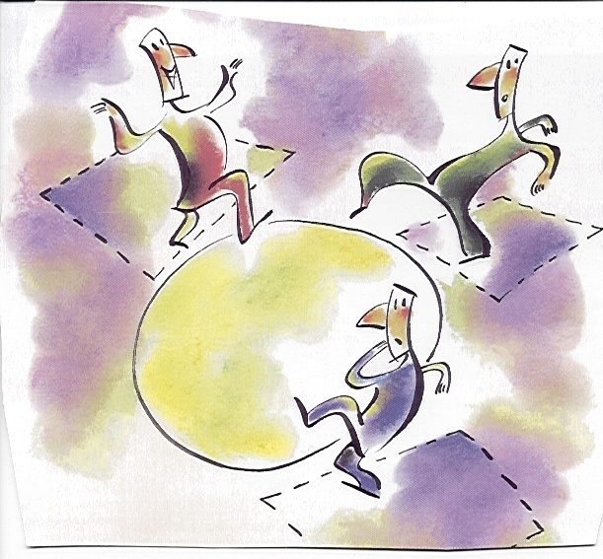
Are You Ready To Step Out?
The New Way
Notes:
Do you accept the challenge?

Slide 176
Pleasant Stay!

Slide 177
Thank you
The Best of Life for
You All!
Abera Demsis (PhD)
abexdd2006@gmail.com
+251911336043

